Slide 1

The working OSI Model

Slide 2
OSI Model

Slide 3
Chapter Objective
Explain the roles and responsibilities of the Open System Interconnection (OSI) model

Slide 4
Questions
List the information required to configure an e-mail client.
Write the difference between MS Outlook and Windows Mail.
List the steps to troubleshoot the problem related to e-mail client.

Slide 5
OSI Model
Run it through CBT

Slide 6
Open System Interconnection (OSI) Model - I
Also known as ISO-OSI Reference Model
Developed by International Organization for Standardization (ISO)
Describes flow of information from one computer to another
Consists of seven layers

Slide 7
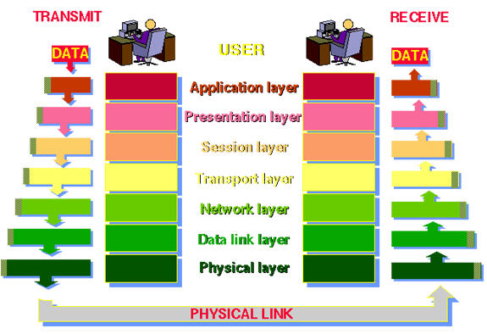
Open System Interconnection (OSI) Model - II

Slide 8
Physical Layer
Is the first or the bottom most layer of the OSI model.
Used to establish or terminate a connection to a communication medium.
Defines the electrical and mechanical specifications like cables, connectors and signaling options of the medium.

Slide 9
Responsibilities of Physical Layer
Characteristics of media –
Encoding –
Transmission Rate –
Transmission Mode –
Topology –

Slide 10
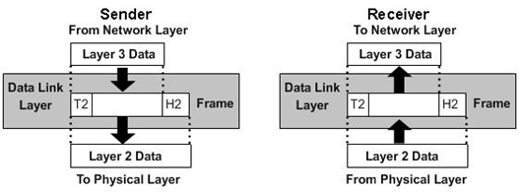
Data Link Layer
Is the second layer of the OSI model.
Handles data transfer between network and the physical layers.
Data unit at the data link layer is called as frame.

Slide 11
Responsibilities of Datalink Layer
Framing –
Physical Addressing – Data link layer adds header to the frame which contains the physical address of the sender and/or receiver.
Error Control – Error control detects and corrects errors. During transmission, if a frame is lost or corrupted, the data link layer retransmits that frame. Error control is accomplished using trailer at the end of the frame.

Slide 12
Group Discussion Time Limit – 3 Mins
List the responsibilities of data link layer.

Slide 13
Network Layer
Is the third layer of the OSI model.
Data unit at this layer is known as packet.
There is no need of the network layer if the two communicating devices lie on the same network.
However, when the two devices are connected on different networks, network layer is essential for providing source to destination delivery of packets.

Slide 14
Responsibilities of Network Layer
Logical Addressing – The data link layer provides physical addressing which is useful for a local network. When the packet is destined for a device outside the network, we require other addressing scheme to identify source and destination. Network layer adds header to the data that includes the logical address (IP address) of the source and destination.
Routing – Routing is a process wherein a proper path is defined for the packets to reach the destination.
Internetworking. – Internetworking means connecting two or more computer networks together. The Internet is the best example of internetworking.

Slide 15
Group Discussion Time Limit – 3 Mins
List the responsibilities of network layer.

Slide 16
Transport Layer
Is the fourth layer of the OSI model.
Data unit at this layer is known as segment.
The network layer deals with source-to-destination delivery of individual packets and does not recognize any relationship between them.
On the other hand, the transport layer ensures that the entire message reaches in order and handles error control and flow control at the source-to destination level.

Slide 17
Responsibilities of Transport Layer - I
Service-point Addressing – There may be number of programs running at the same time on a computer. For this purpose, source-to-destination delivery should also include process-to-process delivery.
Data must be transferred from a specific process (running program) on one computer to a specific process on another computer and to accomplish this, port address is required.
Thus, transport layer includes service-point address (also referred to as port address) in the header. Using these port addresses transport layer delivers the packets to the correct process.

Slide 18
Responsibilities of Transport Layer - II
Segmentation and Reassembly –
Connection Control – Transport layer provides either connection-oriented or connectionless service.
Error Control –

Slide 19
Group Discussion Time Limit – 3 Mins
List the responsibilities of transport layer.

Slide 20
Session Layer
Is the fifth layer of the OSI model.
Establishes, manages, synchronizes and terminates connection between the computers.
Sets up, coordinates and terminates interactions and dialogs between communicating devices.
Provides either half duplex or full duplex service.

Slide 21
Responsibilities of Session Layer
Dialog Control – Is responsible for setting up sessions between communicating devices. It allows two devices to enter into dialog (communication process). These dialogs can take place either in half-duplex or full duplex mode. Dialog control is implemented using a data token. The user that has the token is only allowed to send the data. When the user is done with the operation the token is passed on to next user.
Synchronization – Checkpoints (synchronization bits) are added into a stream of data to synchronize the sessions.

Slide 22
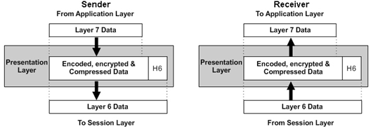
Presentation Layer
Is the sixth layer of the OSI model.
Deals with syntax and semantics of the data exchanged between two devices.
Transforms the data in the format that will be accepted by the application layer.

Slide 23
Responsibilities of Presentation Layer
Translation – The running programs on the computer exchange data in the form of character strings and numbers. Before transmitting, the information should be converted to bit format. The presentation layer handles interoperability between different encoding systems used by different computer systems.
Encryption – Adds security to data by encrypting it.
Compression – Data compression refers to a process of encoding data using less number of bits. This process reduces the number of bits used to represent the information.

Slide 24
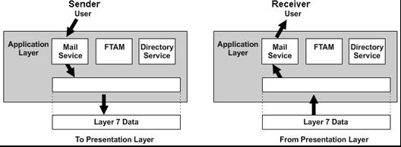
Application Layer
Is the seventh layer of the OSI model.
Provides the means for the user to access information on the network using an application.
Also supports services such as electronic mail, remote file access and transfer and shared database management.

Slide 25
Responsibilities of Application Layer
Network Virtual Terminal – Is a software version of physical terminal. Using this software the user can log on to a computer that is remotely connected on the network.
File Transfer, Access and Management (FTAM) – Using this application user can access files (to make changes) in a remote host. Also enables the user to retrieve and manage files from a remote computer so that the files can be used on a local computer.
Mail Services – Using this application e-mails can be forwarded to another device.
Directory Services – Another service provided by the Application layer is directory services.

Slide 26
Summary of Layers
User information is converted into data in the upper layers
Data is converted into segments in the transport layer
Segments are converted into packets in the network layer
Packets are converted into frames in the data link layer
Frames are converted into bits in the physical layer

Slide 27
Summary - I
OSI model consists of seven layers and provides standards for data communication.
Physical layer is responsible for actual transmission of bits over the medium. It deals with the electrical and mechanical functions.
Data Link layer is responsible for node to node delivery of frames.
Network layer is responsible for end to end delivery of packets and routing.

Slide 28
Summary - II
Transport layer is responsible for end to end delivery of the entire message.
Session layer is responsible for establishing, managing and terminating sessions.
Presentation layer is responsible for translation, encryption and data compression.
Application layer is responsible for providing access to the network resources.

Slide 29
Window Pane
Draw a window pane on OSI layer.

Slide 30
Information is transmitted over a computer network using both analog and digital tech- no logy. Analog technology involves a variation of values used to represent information. In contrast, digital technology uses two values.

